Slide 1
Week 6/7 – Fact Recording
AACS2192 Analysis and Design of IS - Case Study
Library System

Slide 2
Context Diagram

Slide 3
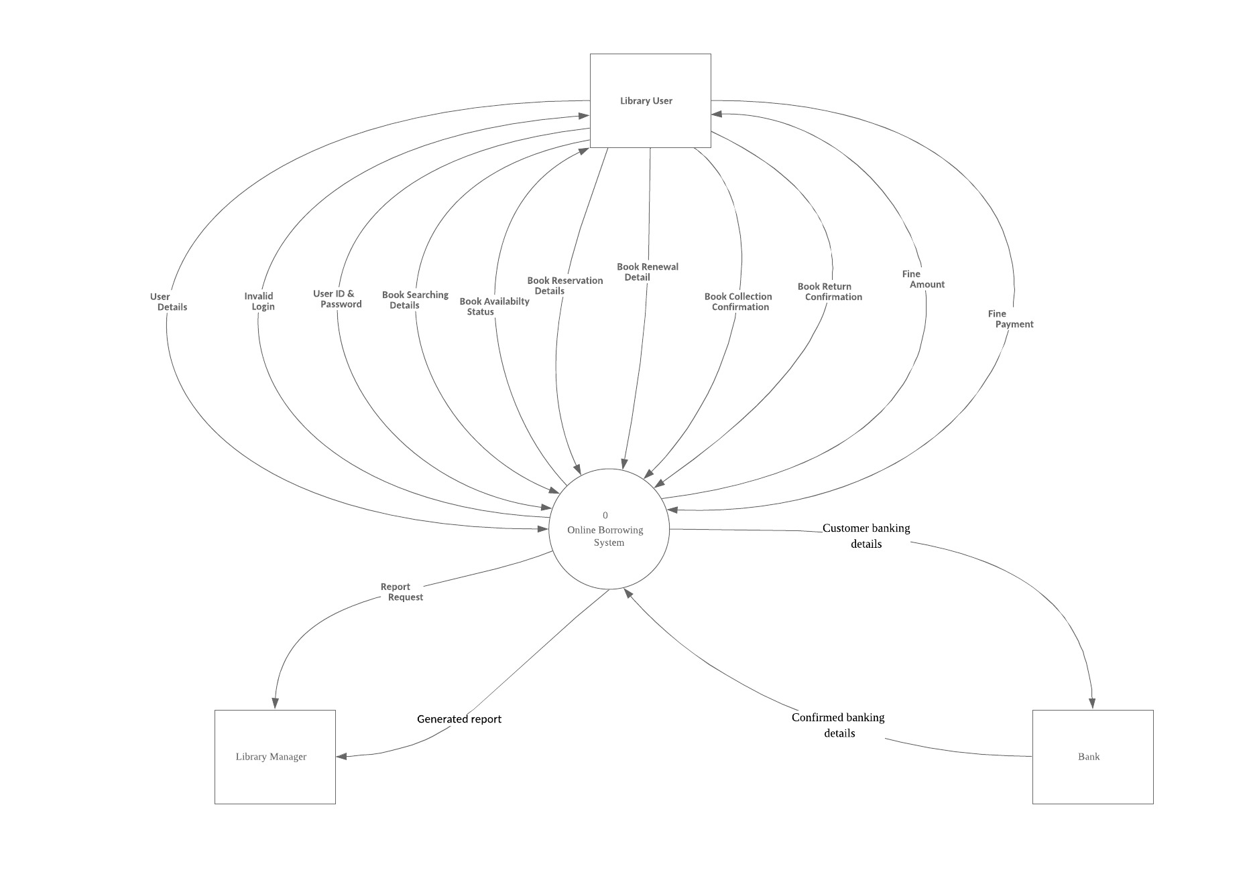

Slide 4
DFD 0 Diagram

Slide 6
DFD１Diagram

